Slide 1
HOW DO WE REACH DIFFERENT PEOPLE? IN DIFFERENT WAYS!
JÖNKÖPING
LOTTA OLSSON

Slide 2
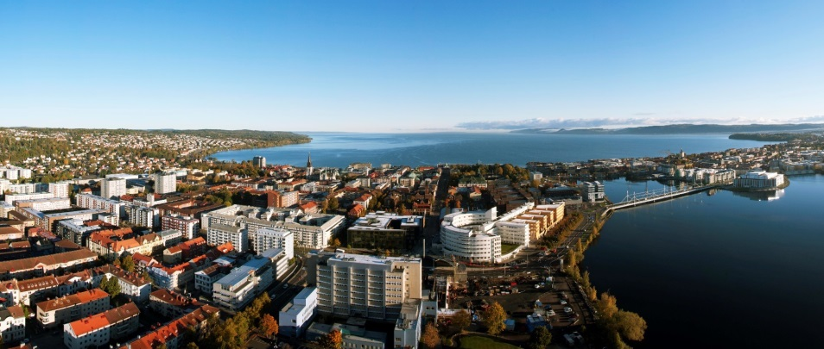
How do we reach different people? In different ways!
Stadsbyggnadskontoret
2020-04-23
Lotta Olsson

Slide 3
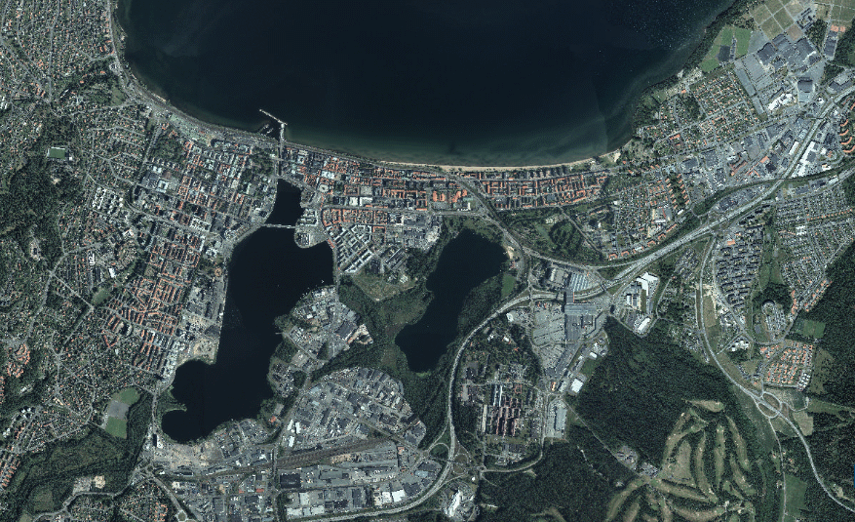
Stadsbyggnadskontoret
2020-04-23
Jönköpings kommun!
140.000 residents
The main city is Jönköping
17 villages/towns

Slide 4
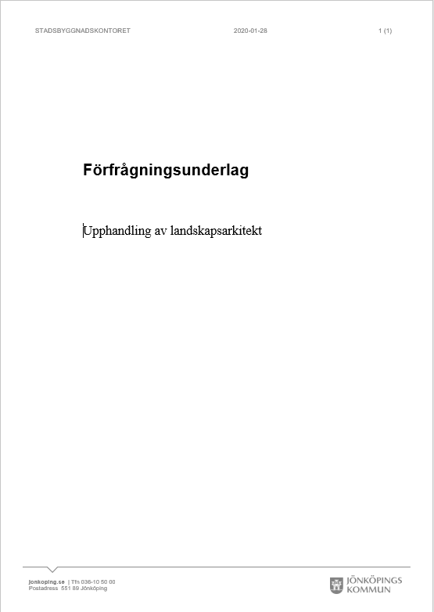
How we worked with our bicycle strategy!
Other projects that has followed!

Slide 5
It started with the bicycle strategy in 2017

Slide 6
The traditional way of inviting to public meetings that Jönköping do attracts men!
Not just men, not all men – but…
…middle aged to old white men.
They matter, their knowlage and point of view are important. But they are not the only ones that matters and are important!
All are!

Slide 7
Gender equality in focus through the work with the bicycle strategy
Benchmarking with Umeå kommun – they have worked a long time with gender equality
We required experience working with gender equality from the consultants we choosed to work with.
During the process the working groups involved both men and women
The national political goals about gender equality was our goal through the whole working progress
Other equality mesurements has been payed attention too as well, like children and elderly.
We wanted to know what people i Jönköping thought about bicycling here and what was important to them. The goal was to reach all kinds of people

Slide 8
How do we reach different people? In different ways!
Opinion about the program – Pressrelease, web, social media and directed mailing
An open poll with five questions about cykling – web, press, social media and meetings with citizens.
Jönköping city’s web page, Facebook page and Instagram
Pop up-meetings with citizens
Rosenlundsskolan (school, 7th to 9th grade)
A horseriding club
Öxnehaga library (language café for newcommers)
City library of Jönköping
Entrance hall of Jönköping University
Notes:
Riktade utskick till Förvaltningar, politiker, Umeå, Cykelfrämjandet mfl.
Riktade annonser på FB unga och äldre

Slide 9
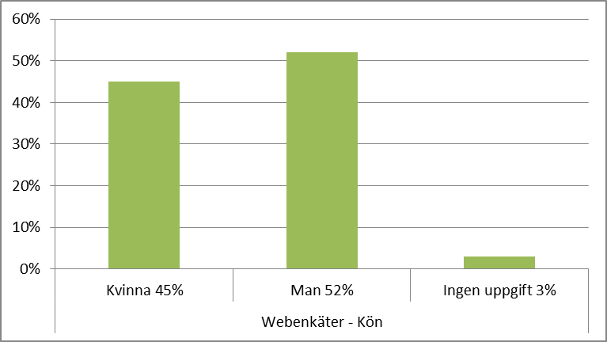
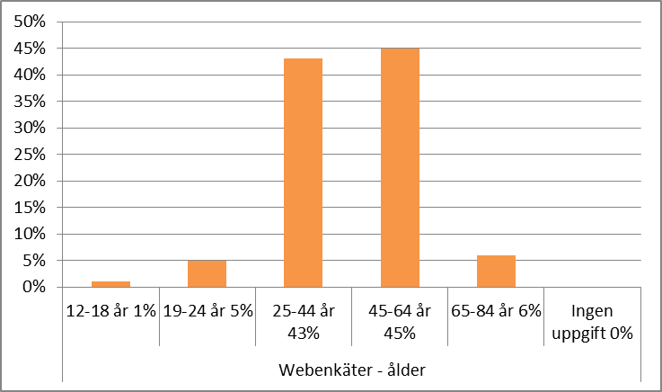
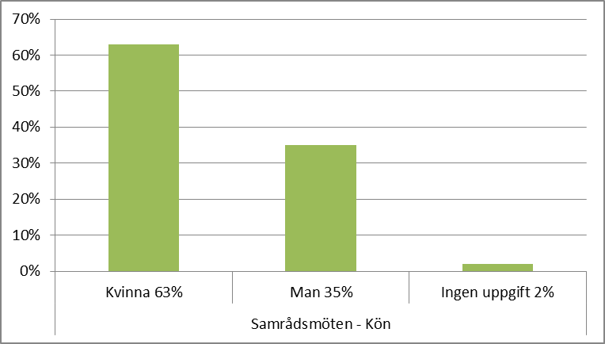
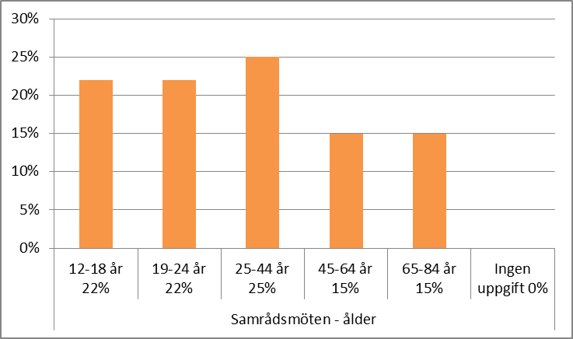
117 answers from web
91 answers at meetings
The Poll

Slide 10
Conclution!
Much simpler than expected!

Slide 11
Other projects, some examples!
Public contracting of a landscape architect
Shape a new park/place

Slide 12
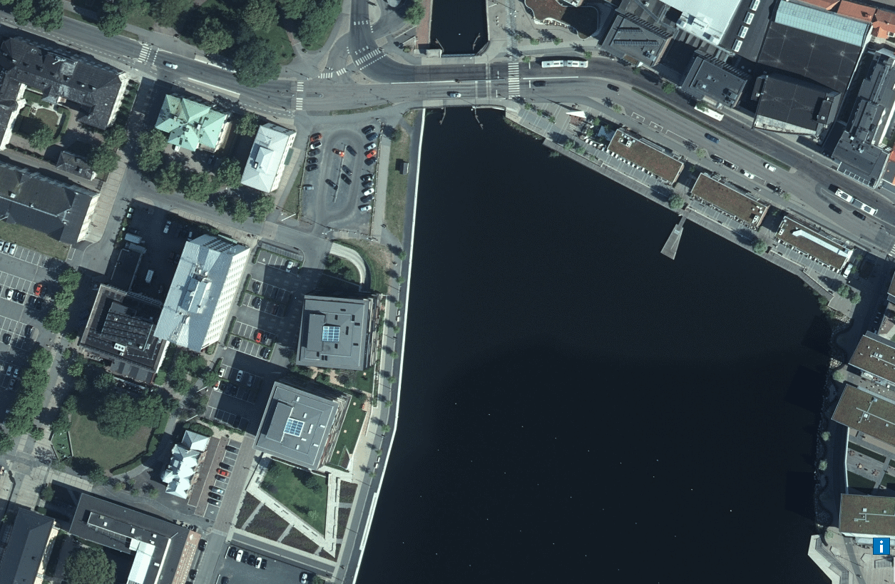
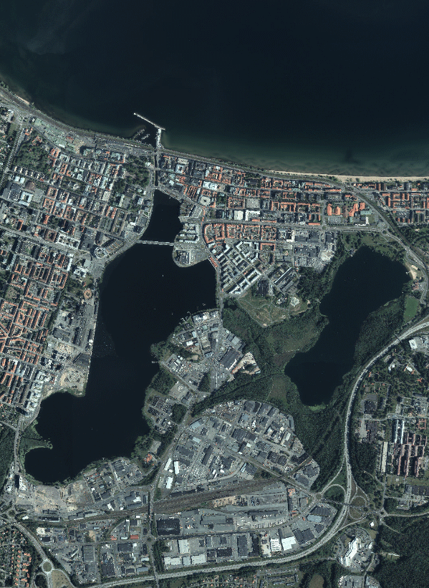
Magnus Ladulås Plats

Slide 13
Magnus Ladulås Plats
We asked other questions!

Slide 14
How do you want to feel in this place?
106 Restful
72 Greed
71 Welcomming
57 Social
47 Open
37 Inviting
37 Natural
37 Safe
32 Cozy
30 Joyful
28 Historical
27 Nice
22 Comfortable
22 Happyness
21 Water
18 Pride
18 Beautiful
16 Generations
16 Aktive
16 Puls
15 Exciting
14 Eventful
13 Creativ
12 Modern
11 Healthy
9 Spacial
9 Silent

Slide 15
TACK!
Lotta Olsson
Traffic planning, bicycle
Jönköpings Kommun
lotta.olsson@jonkoping.se

